Slide 1


TabFact: A Large-scale Dataset for Table-based Fact Verification
Wenhu Chen, William Wang, et al.

Slide 2
Related Research
Fact Verification is a general natural language understanding problem.
World
Evidence
Entailed/
Refuted
Textual Hypothesis

Slide 3
Related Research
Recognizing Textual Entailment (Dagan et al. 2006)
Recognizing containment relationship.
Natural Language Inference (Bowman et al. 2015)
Recognizing inference relationship.
Fact Checking (Thorne et al. 2018)
Verify claims based on whole Wikipedia
Sentence;
Passages
Entailed/
Refuted
Textual Hypothesis

Slide 4
Free-form Evidence
The previous works are mainly based on free-form corpus as evidence.
Can we go further to utilize other evidence forms to
do fact verification?

Slide 5
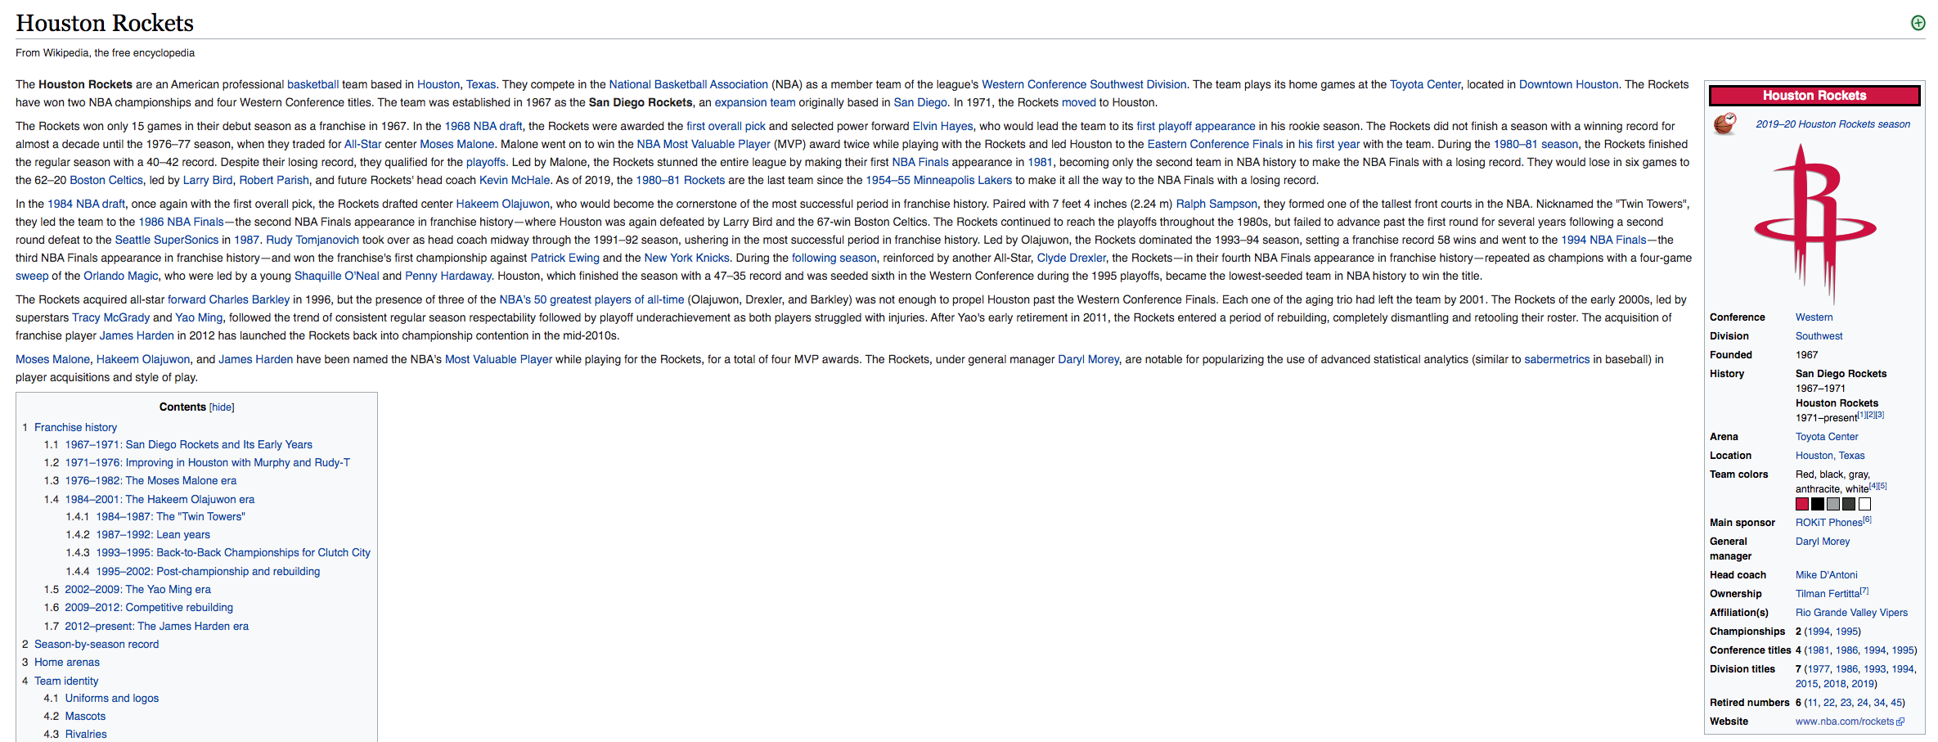
Free-form Evidence
Source: https://en.wikipedia.org/wiki/Houston_Rockets
Claim:
Houston Rocket won 45 games in 12-13 season.

Slide 6
Free-form Evidence
Source: https://en.wikipedia.org/wiki/Houston_Rockets
Claim:
Houston Rocket won 45 games in 12-13 season.

Slide 7
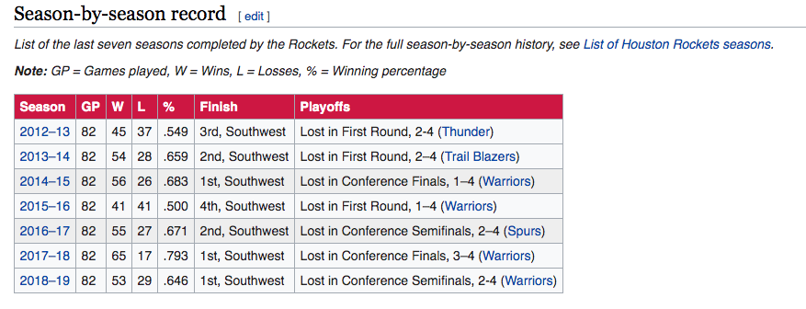
Free-form Evidence
Source: https://en.wikipedia.org/wiki/Houston_Rockets
Claim:
Houston Rocket won 45 games in 12-13 season.

Slide 8
Free-form Evidence
Source: https://en.wikipedia.org/wiki/Houston_Rockets
Claim:
Houston Rocket won 45 games in 12-13 season.

Slide 9
Free-form Evidence
World knowledge is distributed in heterogeneous forms, using free-form text is insufficient.
Under many circumstances, we need to resort to other evidence forms to do fact verification.

Slide 10
TabFact Dataset
We explore the fact verification problem under semi-structured Wikipedia tables.
Ubiquitous in real-world
Structured and un-structured Information
TabFact Dataset
16K open-domain Wikipedia tables
118K human-annotated statements divided into entailed or refuted categories.

Slide 11
TabFact Examples
United States House of Representatives Elections, 1972
District | Incumbent | Party | Result | Candidates
California 3 | John E. Moss | democratic | re-elected | John E. Moss (d) 69.9% John Rakus (r) 30.1%
California 5 | Phillip Burton | democratic | re-elected | Phillip Burton (d) 81.8% Edlo E. Powell (r) 18.2%
California 8 | George Paul Miller | democratic | lost renomination democratic hold | Pete Stark (d) 52.9% Lew M. Warden , Jr. (r) 47.1%
California 14 | Jerome R. Waldie | republican | re-elected | Jerome R. Waldie (d) 77.6% Floyd E. Sims (r) 22.4%
California 15 | John J. Mcfall | republican | re-elected | John J. Mcfall (d) unopposed
1. In the election, four out of five incumbents are re-elected.

Slide 12
TabFact Examples
United States House of Representatives Elections, 1972
District | Incumbent | Party | Result | Candidates
California 3 | John E. Moss | democratic | re-elected | John E. Moss (d) 69.9% John Rakus (r) 30.1%
California 5 | Phillip Burton | democratic | re-elected | Phillip Burton (d) 81.8% Edlo E. Powell (r) 18.2%
California 8 | George Paul Miller | democratic | lost renomination democratic hold | Pete Stark (d) 52.9% Lew M. Warden , Jr. (r) 47.1%
California 14 | Jerome R. Waldie | republican | re-elected | Jerome R. Waldie (d) 77.6% Floyd E. Sims (r) 22.4%
California 15 | John J. Mcfall | republican | re-elected | John J. Mcfall (d) unopposed
2. John E. Moss and George Paul Miller are both re-elected in the house of representative election.

Slide 13
Challenges
Mixed Reasoning in Semi-Structured Information

Slide 14
Challenges
Mixed Reasoning in Semi-Structured Information
Linguistic Reasoning on semantic-level
Result | Candidates
re-elected | John E. Moss (d) 69.9% John Rakus (r) 30.1%
re-elected | Phillip Burton (d) 81.8% Edlo E. Powell (r) 18.2%
lost renomination democratic hold | Pete Stark (d) 52.9% Lew M. Warden , Jr. (r) 47.1%
re-elected | Jerome R. Waldie (d) 77.6% Floyd E. Sims (r) 22.4%
re-elected | John J. Mcfall (d) unopposed

Slide 15
Challenges
Mixed Reasoning in Semi-Structured Information
Linguistic Reasoning on semantic-level
Symbolic Reasoning on structure-level
Result | Candidates
re-elected | John E. Moss (d) 69.9% John Rakus (r) 30.1%
re-elected | Phillip Burton (d) 81.8% Edlo E. Powell (r) 18.2%
lost renomination democratic hold | Pete Stark (d) 52.9% Lew M. Warden , Jr. (r) 47.1%
re-elected | Jerome R. Waldie (d) 77.6% Floyd E. Sims (r) 22.4%
re-elected | John J. Mcfall (d) unopposed
District | Incumbent | Party
California 3 | John E. Moss | democratic
California 5 | Phillip Burton | democratic
California 8 | George Paul Miller | democratic
California 14 | Jerome R. Waldie | republican
California 15 | John J. Mcfall | republican

Slide 16
Models
Latent Program Analysis
Semantic-parsing baseline
Synthesize the latent logic forms for the statement and execute the logic form against table to verify.
Table BERT
NLI baseline
Linearize the table as paragraph of sentences, then use large-scale pre-trained language model to verify.

Slide 17
Latent Program Analysis
Latent Program Analysis
There are more democrats than republicans in the election.
Table

Slide 18
Latent Program Analysis
Latent Program Analysis
There are more democrats than republicans in the election.
Feature-based Entity Linking
Search
Table

Slide 19
Latent Program Analysis
Latent Program Analysis
There are more democrats than republicans in the election.
Feature-based Entity Linking
Search
Table
String
Party
democratic
Party
republican
Notes:
Change the keys

Slide 20
Latent Program Analysis
Latent Program Analysis
There are more democrats than republicans in the election.
Feature-based Entity Linking
Search
Table
String
Party
democratic
Party
republican
V1=Filter(T, incumbent==democratic))
View
Sub
V1

Slide 21
Latent Program Analysis
Latent Program Analysis
There are more democrats than republicans in the election.
Feature-based Entity Linking
Search
Table
String
Party
republican
Sub
V1
V2=Filter(T, incumbent==republican))
View
Sub
V2

Slide 22
Latent Program Analysis
Latent Program Analysis
There are more democrats than republicans in the election.
Feature-based Entity Linking
Search
Party
democratic
democratic
democratic
republican
republican
Table
Sub
V1
Sub
V2
3=Count(V1)
Num
Count
3

Slide 23
Latent Program Analysis
Latent Program Analysis
There are more democrats than republicans in the election.
Feature-based Entity Linking
Search
Party
democratic
democratic
democratic
republican
republican
Table
Sub
V2
Count
3
2=Count(V2)
Num
Count
2

Slide 24
Latent Program Analysis
Latent Program Analysis
There are more democrats than republicans in the election.
Feature-based Entity Linking
Search
Party
democratic
democratic
democratic
republican
republican
Table
Count
3
Count
2
Greater(3, 2)
Bool
True
Entailed

Slide 25
Table-BERT
Scanning the Table
Game | Date | Opponent | Score
51 | February 3 , 2009 | Florida | 3-4
52 | February 4 , 2009 | Buffalo | 0-5
53 | February 7 , 2010 | Montreal | 5-2
Horizontal Scan

Slide 26
Table-BERT
Scanning the Table
Game | Date | Opponent | Score
51 | February 3 , 2009 | Florida | 3-4
52 | February 4 , 2009 | Buffalo | 0-5
53 | February 7 , 2010 | Montreal | 5-2
Horizontal Scan
Row one game is 51, date is February 3, 2009 … Row two
Game is 52, date is February 4, 2009, …

Slide 27
Table-BERT
Template the table with natural language
Word
[CLS]
row
one
game
is
51
;
date
is
February
3
Position
0
1
2
3
4
5
6
7
8
9
10

Slide 28
Table-BERT
Concatenate the statement
Word
[CLS]
row
one
game
[SEP]
in
the
game
Position
0
1
2
3
10
11
12
13
Table
Statement

Slide 29
Table-BERT
BERT NLI Framework
Label
12-Layer BERT-Base Model
Word
[CLS]
row
one
game
[SEP]
in
the
game
Position
0
1
2
3
10
11
12
13
Table
Statement

Slide 30
Table-BERT
BERT NLI Framework
Support
Refute
Label
12-Layer BERT-Base Model
Word
[CLS]
row
one
game
[SEP]
in
the
game
Position
0
1
2
3
10
11
12
13
Table
Statement

Slide 31
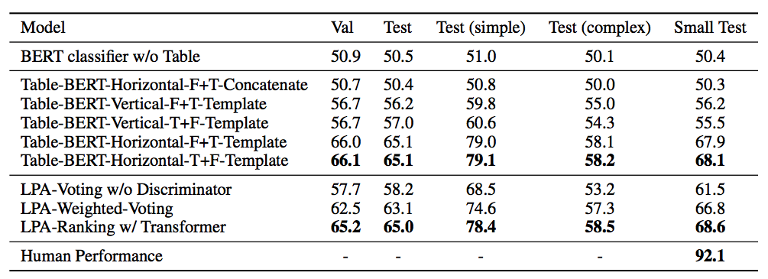
Experimental Results

Slide 32
Experimental Results

Slide 33
Experimental Results
Latent Program Analysis
Pros: robust and explainable
Cons: Heavily rely on entity linking, the execution pipeline requires hand-written rules

Slide 34
Experimental Results
Latent Program Analysis
Pros: robust and explainable
Cons: Heavily rely on entity linking, the execution pipeline requires hand-written rules
Table BERT
Pros: simple and general
Cons: training unstable, black-box without explainability

Slide 35
Conclusion
Both Proposed Symbolic and Neural models have pros and cons.
How to design a a unified model to combine both linguistic and symbolic reasoning remains an important open problem.

